Slide 1


Vivekananda College of Engineering & Technology
[A Unit of Vivekananda Vidyavardhaka Sangha Puttur®] Affiliated to Visvesvaraya Technological University
Approved by AICTE New Delhi & Recognised by Govt of Karnataka
“KABADDI SCORECARD AUTOMATION”
Guided by:
Prof. Sapna K N
Assistant Professor
Dept. of CSE(Data Science)
Presented by:
Adarsha S P (4VP21CD007)
Manish (4VP21CD025)
Pranam K R (4VP21CD036) Shridatha S (4VP21CD049)

Slide 2
CONTENTS
Introduction
Objectives
Problem Statement
Literature Survey
Proposed System
Methodology
Results
Conclusion
References

Slide 3
INTRODUCTION
Kabaddi, a fast-paced and physically demanding sport, traditionally relies on manual methods for scorekeeping, which can be labor-intensive and potentially prone to human error during intense matches.
The 'Kabaddi Scorecard Automation' project introduces a technological solution to streamline this process.
It utilizes Python, Flask, OpenCV, and MediaPipe to analyze live video feeds, detect specific umpire gestures and poses indicative of scoring actions, and presents this information through an interactive web interface, ultimately enhancing the accuracy and efficiency of managing Kabaddi scores.

Slide 4
OBJECTIVES
Overcome Manual Workload
Use computer vision (MediaPipe) to detect scoring gestures/poses in real-time video.
Develop a web application with user authentication for control and live feed visualization.
Allow users to start/stop sessions, track scores automatically based on detections, and monitor match time.
Enable saving and viewing of completed match data locally.

Slide 5
PROBLEM STATEMENT:
In the traditional Kabaddi matches, scorekeeping is performed manually by officials who depending on visual observation and physical documentation of the umpire's signals.
This manual process is prone to human error, delays, and inconsistencies, especially in fast-paced game environments.
To Avoid these issues, Our project aims to develop an automated scorecard system that leverages computer vision techniques to recognize and interpret umpire gestures in real-time.

Slide 6
LITERATURE REVIEW
Sun et al [1] conducted a survey on 2D human pose estimation from monocular images, highlighting advancements and challenges using a single camera. The authors reviewed model-based and learning-based methods, and discussed combining approaches and real-time application issues.
Andi M. A. Siddik et al. [2] proposed an ensemble transfer learning model combining VGG-19 and ResNet-50 for ASL digit recognition, achieving 99.03% accuracy and showcasing strong performance on small datasets.
Xianghong Cao et al. [3] introduced a PSE-CNN-BiGRU model for human posture recognition using Mediapipe, CNN, BiGRU, and SENet, achieving 99.56% accuracy and demonstrating robustness for applications in smart healthcare and elderly monitoring.

Slide 7
PROPOSED SYSTEM
Python programming language for backend development.
Flask web framework for building the backend server and handling routes.
OpenCV library for real-time video capture from the webcam.
MediaPipe framework for pose and hand landmark detection and gesture recognition.
HTML, CSS, and JavaScript for creating the interactive frontend web interface.
Browser Local Storage for saving and retrieving match data locally.
User authentication implemented via Flask sessions for secure access.

Slide 8
METHODOLOGY
Capture live video from a webcam using OpenCV.
Process each video frame with MediaPipe to detect pose and hand landmarks.
Analyze detected landmarks to identify specific hand gestures related to Kabaddi scoring.
Label the detected gestures and overlay them on the video frames.
Stream the processed video frames to the frontend via Flask.
Implement user authentication to secure access to the system.
Provide a web interface to start/stop video capture, display live video, and show real-time scores.
Automatically update scores based on detected gestures with a timer for match duration.
Allow manual score adjustments and input of team names and match number.
Save match data locally in the browser and provide a way to view saved matches.

Slide 9
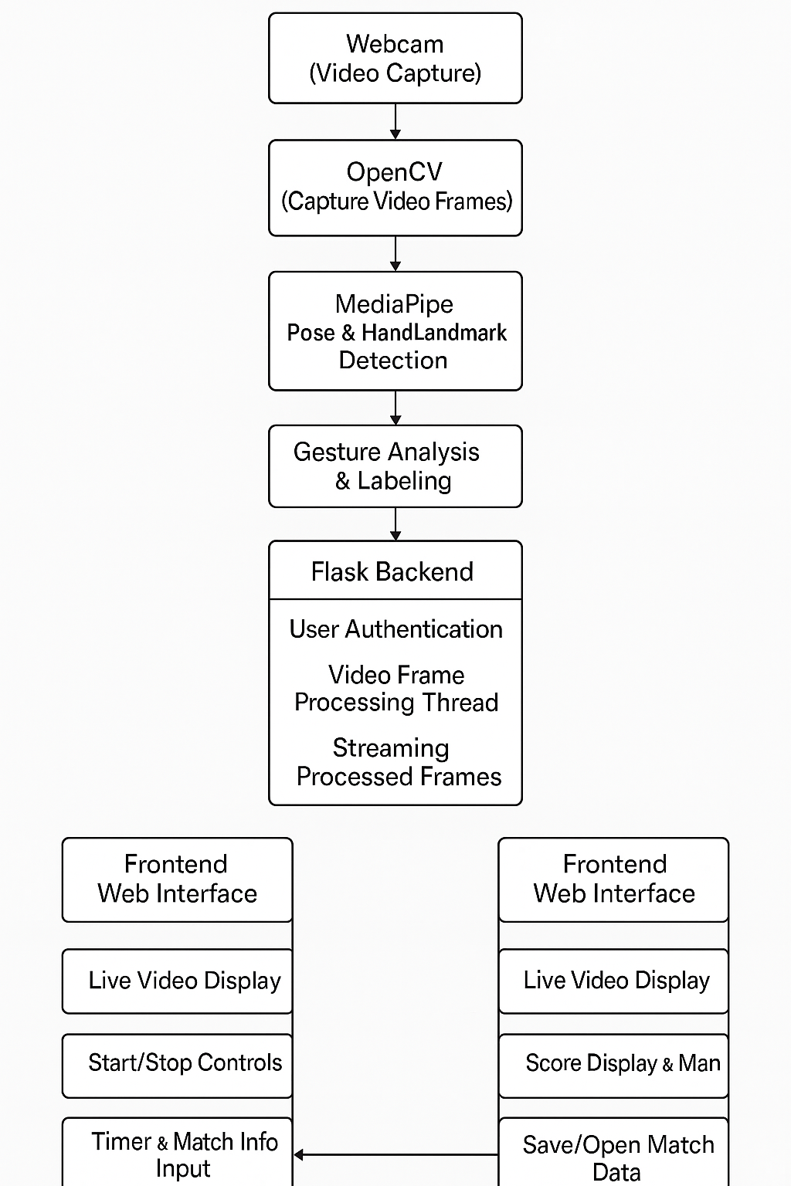
Figure 1 : Flow Diagram

Slide 10
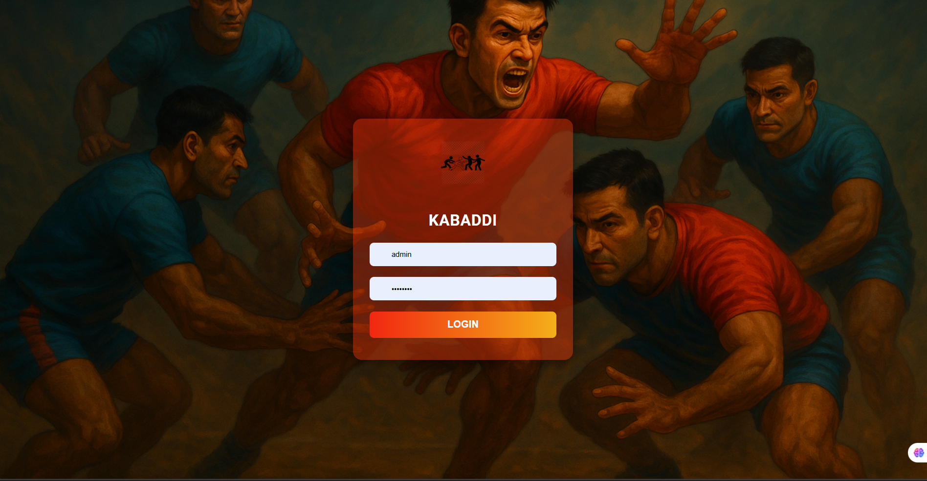
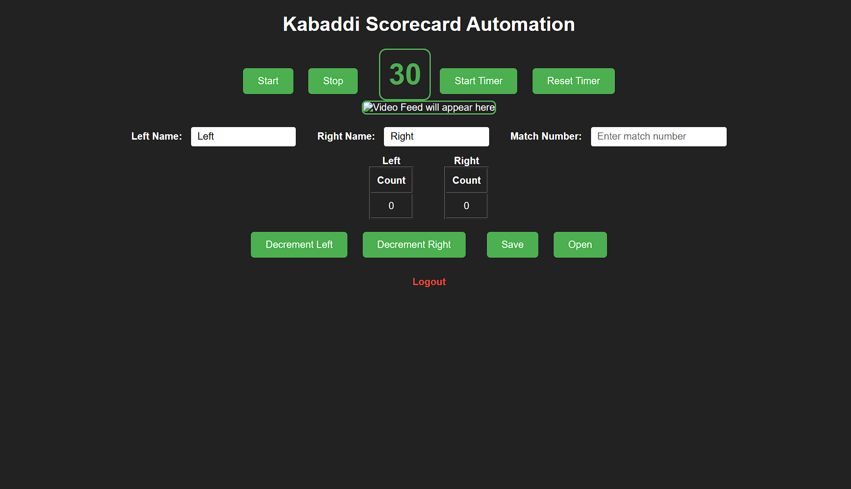
RESULTS
Figure 1 : Login Page
Figure 2 : Home Page

Slide 11
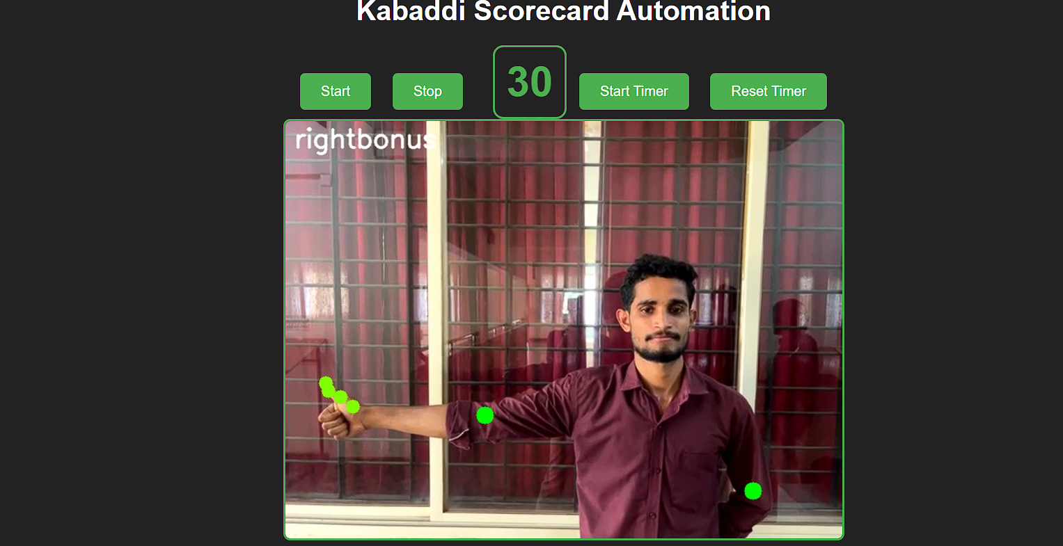
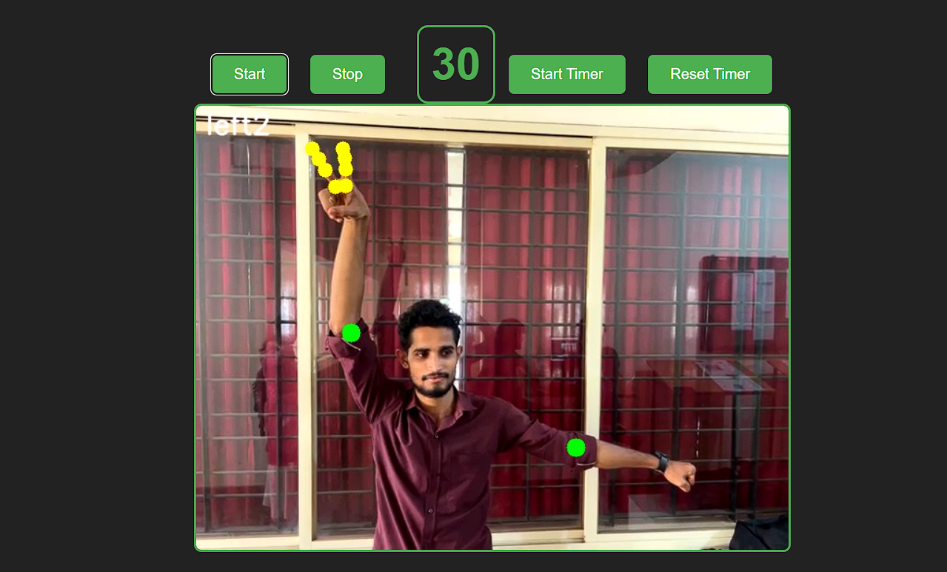
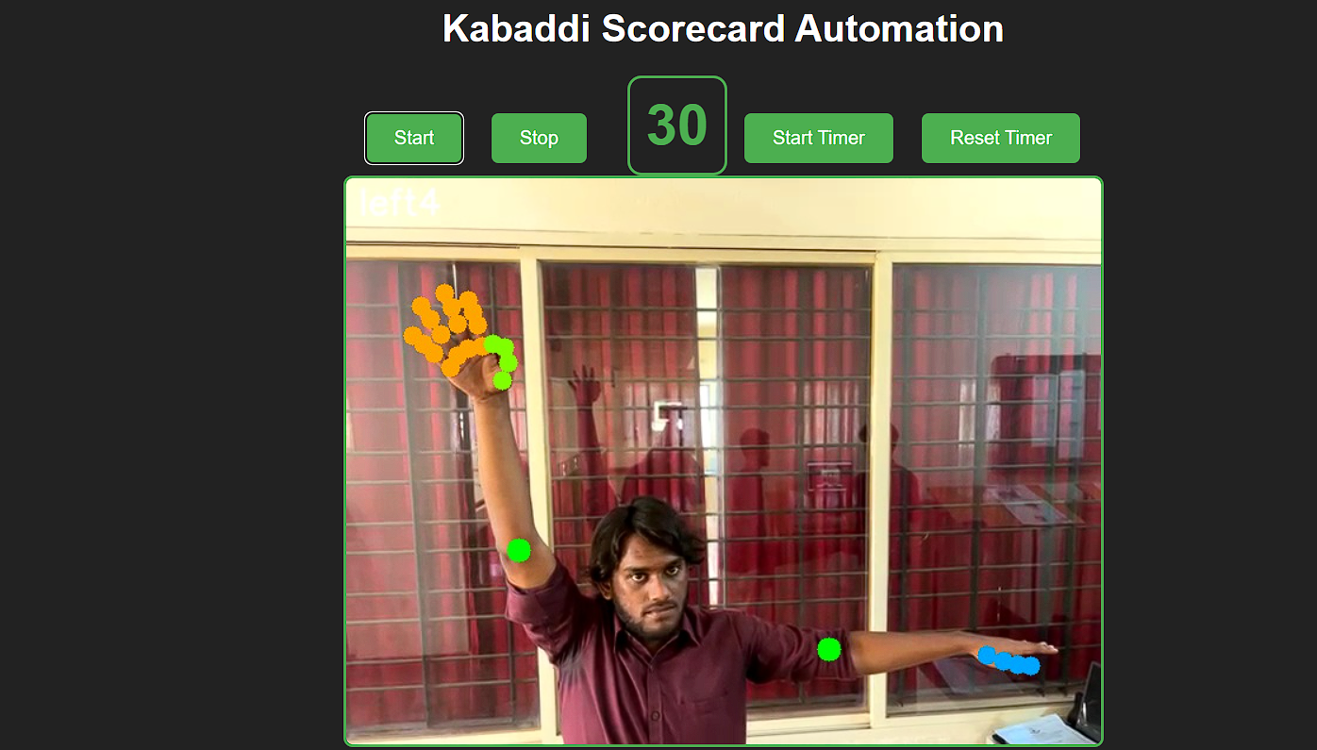

Figure 3 :Snapshot of result
Figure 4 : Snapshot of result
Figure 5 : Snapshot of result
Figure 6 : Saved Data

Slide 12
CONCLUSION
This project successfully demonstrates the automation of Kabaddi scorekeeping using computer vision and web technologies.
By combining real-time gesture detection with an interactive web interface, it simplifies the scoring process, reduces human error, and enhances match management.
The system provides a foundation for further improvements and broader applications in sports analytics and automation.

Slide 13
REFERENCES
[1] Sun, J. Chen, X. Lu, Y. Cao, J, “2DHuman Pose Estimation from MonocularImages”, 2020.
[2] Andi Muhammad Amil Siddik, AinunMawaddah Abdal, Armin Lawi, EdySaputra Rusdi, “Ensemble TransferLearning for Hand-sign Digit ImageClassification”, 2021.
[3] Xianghong Cao, Xinyu Wang, Xin Geng,Donghui Wu, Houru, “An Approach forHuman Posture Recognition Based onthe Fusion PSE-CNN-BiGRU Model”,2021.

Slide 14
THANK YOU

